Slide 1





INTERN PROJECT
Intern Project: Research AXI4-Lite then integrated into Soc
Đinh Khánh Đăng - Phạm Chí Đạt
https://github.com/DinhKhanhDang27/AXI4_LITE
03
Theoretical part
Vivado Code Coverage
RTL Design
Real Project
PORTFOLIO
Copyrights 2026 CE-UIT. All Rights Reserved.

Slide 2
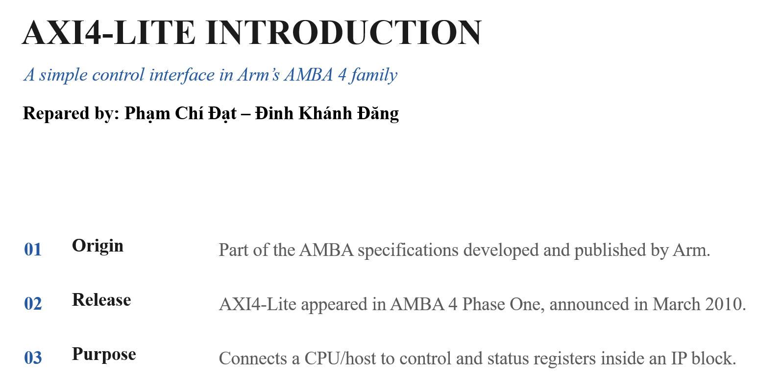
KHOA KỸ THUẬT MÁY TÍNH

Slide 3
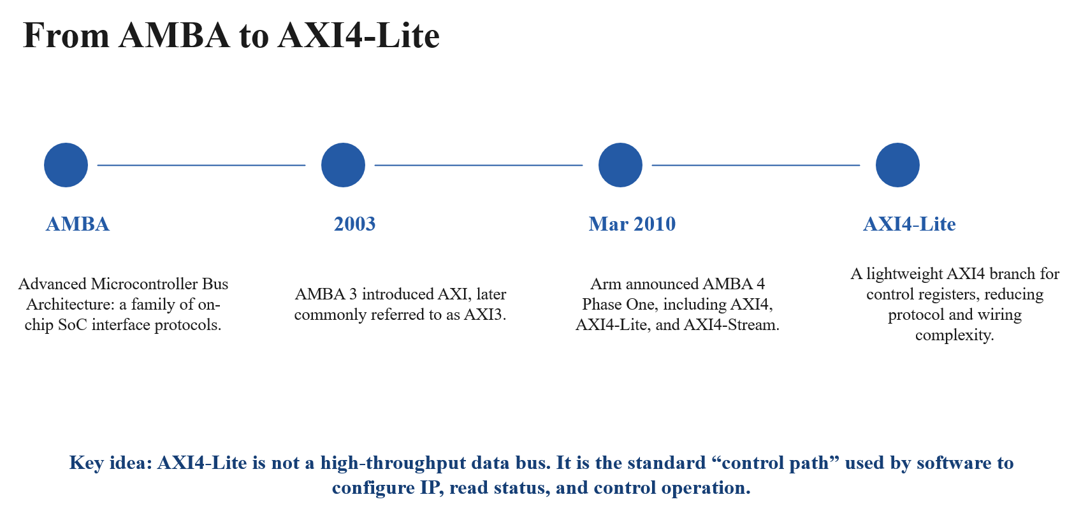
KHOA KỸ THUẬT MÁY TÍNH

Slide 4
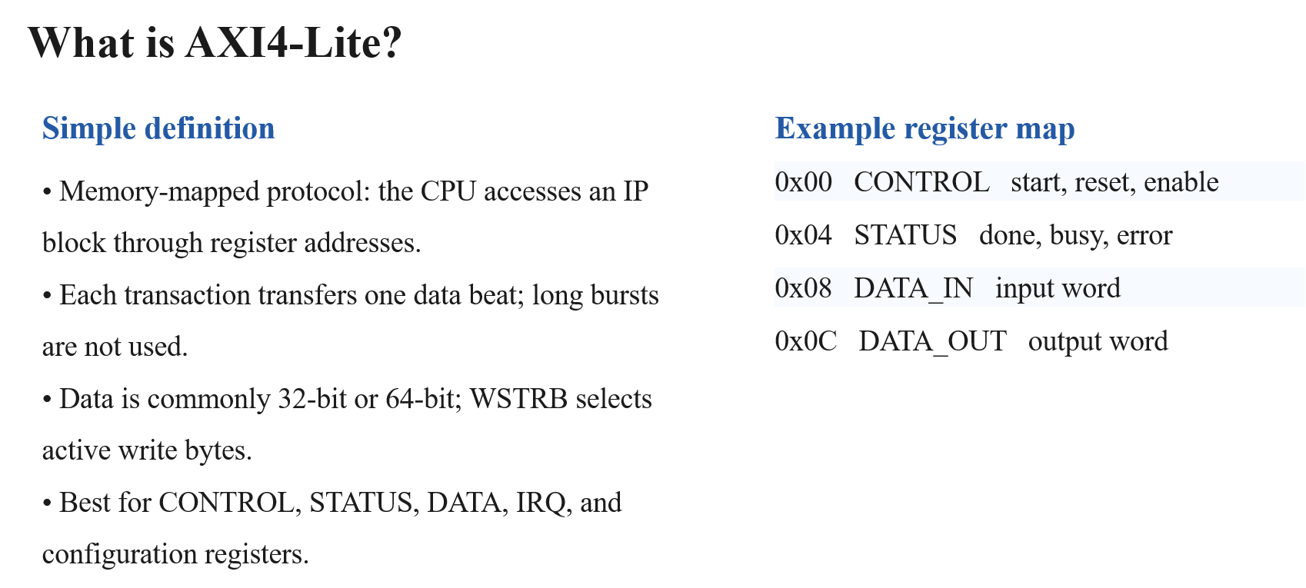
KHOA KỸ THUẬT MÁY TÍNH

Slide 5
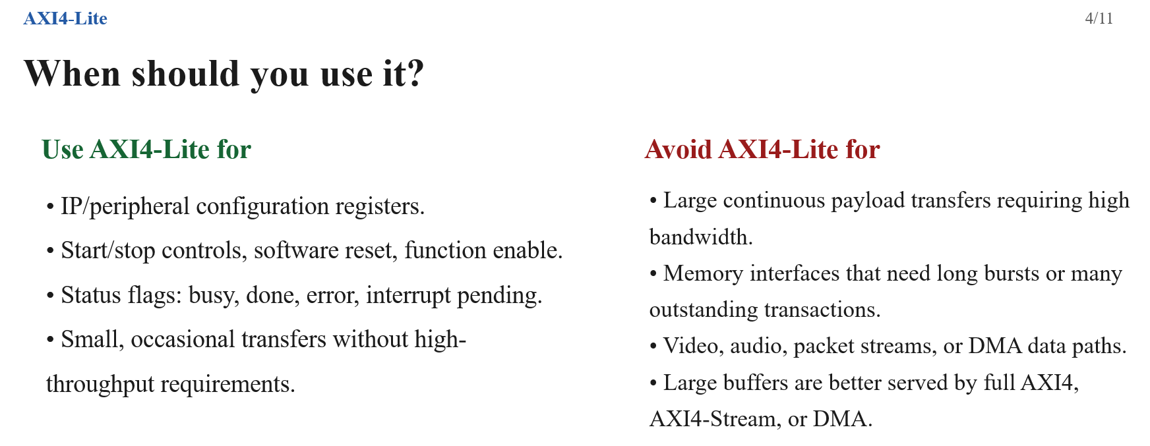
KHOA KỸ THUẬT MÁY TÍNH

Slide 6
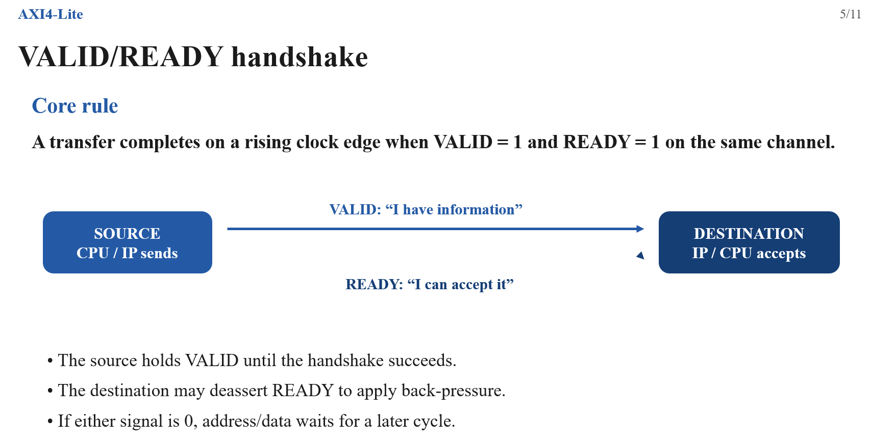
KHOA KỸ THUẬT MÁY TÍNH

Slide 7
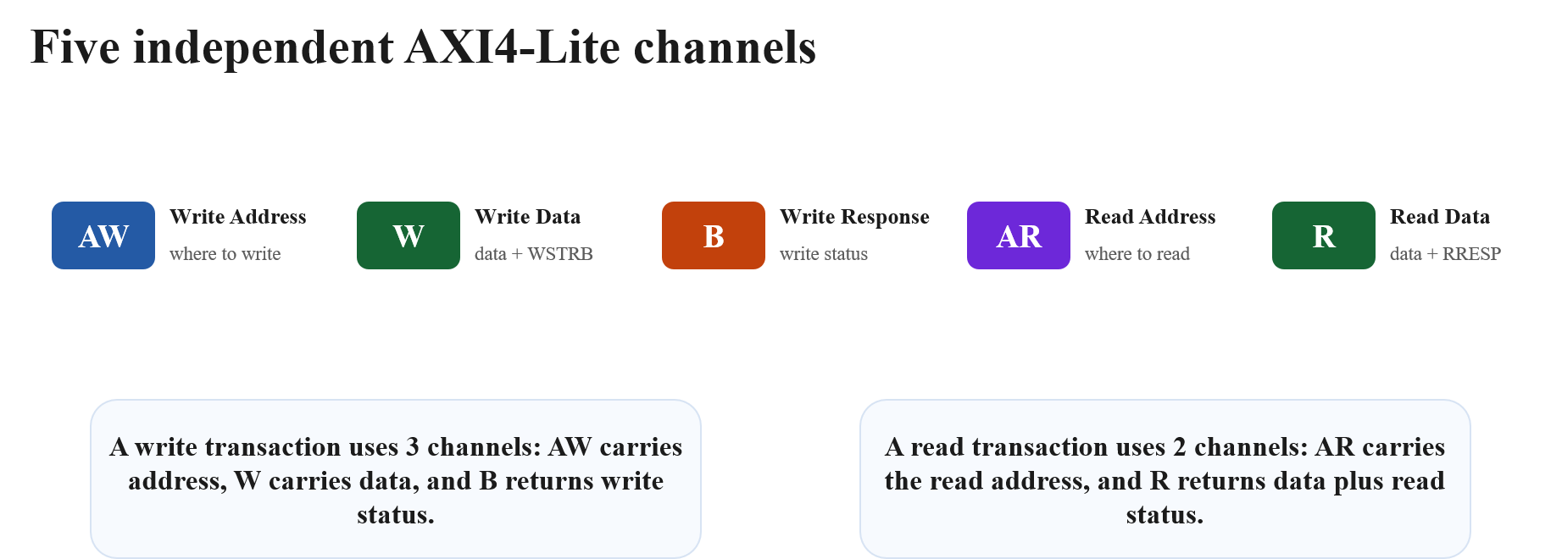
KHOA KỸ THUẬT MÁY TÍNH

Slide 8
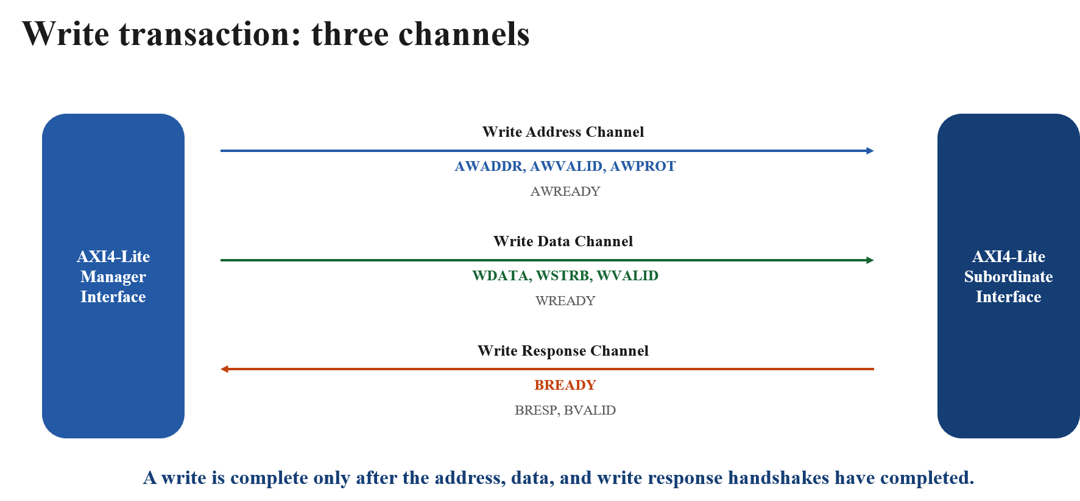
KHOA KỸ THUẬT MÁY TÍNH

Slide 9
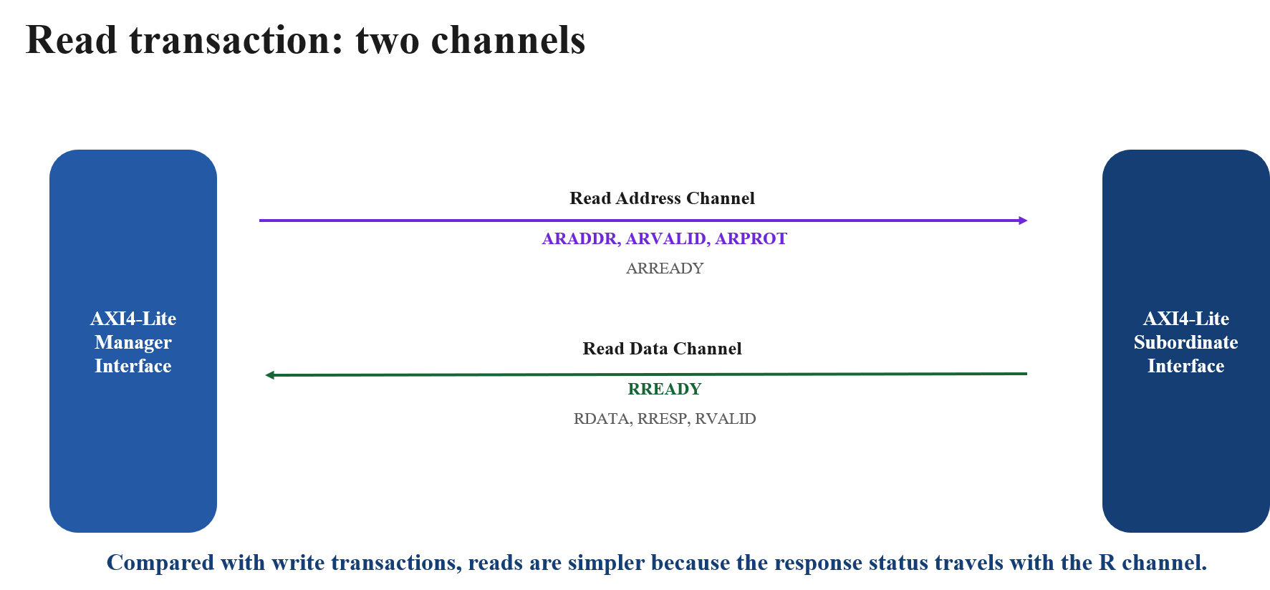
KHOA KỸ THUẬT MÁY TÍNH

Slide 10
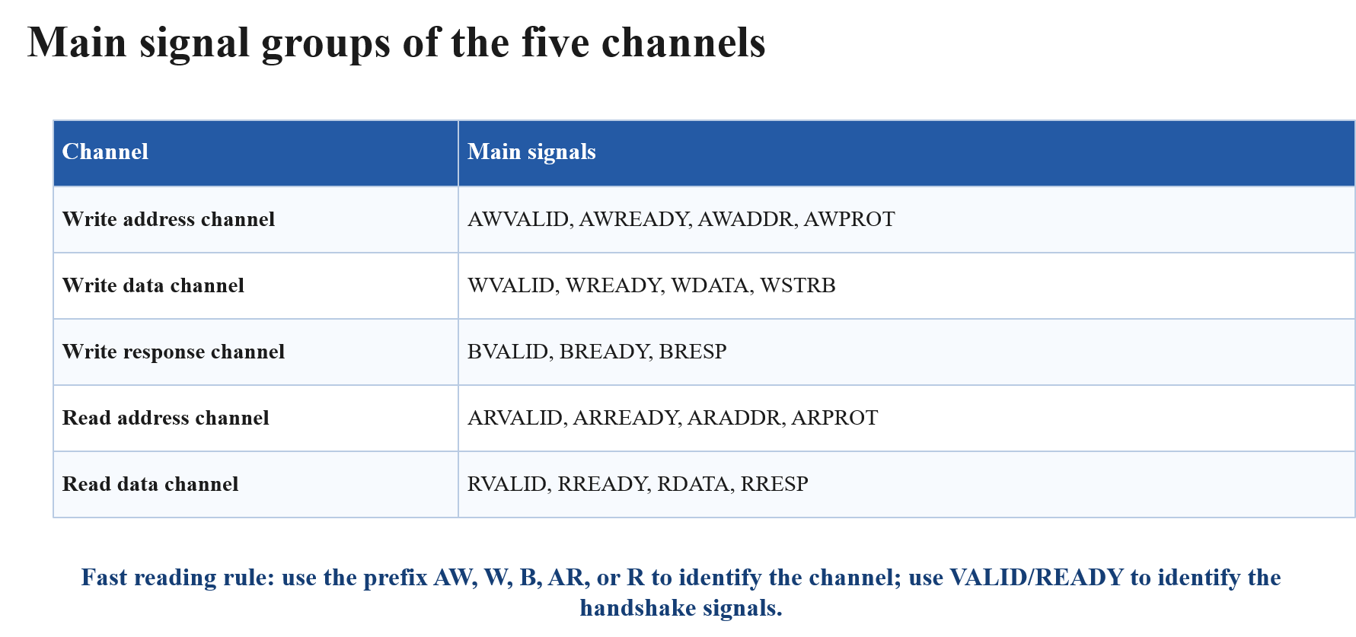
KHOA KỸ THUẬT MÁY TÍNH

Slide 11
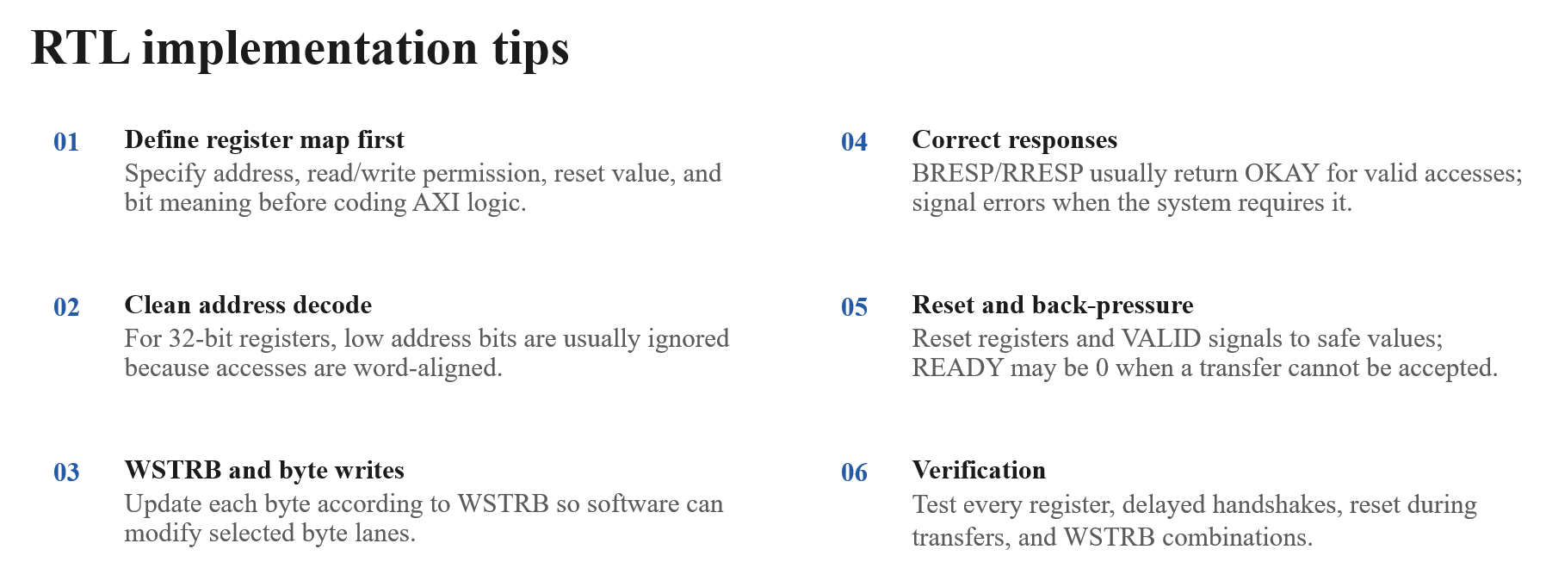
KHOA KỸ THUẬT MÁY TÍNH

Slide 12
INTERN PROJECT
Intern Project: AXI4-Lite Verification for ALU Peripheral
Verify a 32-bit ALU peripheral controlled via AXI4-Lite / Avalon-MM bus.
Đinh Khánh Đăng - Phạm Chí Đạt
https://github.com/DinhKhanhDang27/AXI4_LITE
01
02
03
04
RTL Design
Testbench
Vivado Code Coverage
Quartus / Qsys Integration
PORTFOLIO
5 RTL modules and 3 testbenches implemented.
PROJECT STATUS
Copyrights 2026 CE-UIT. All Rights Reserved.

Slide 13
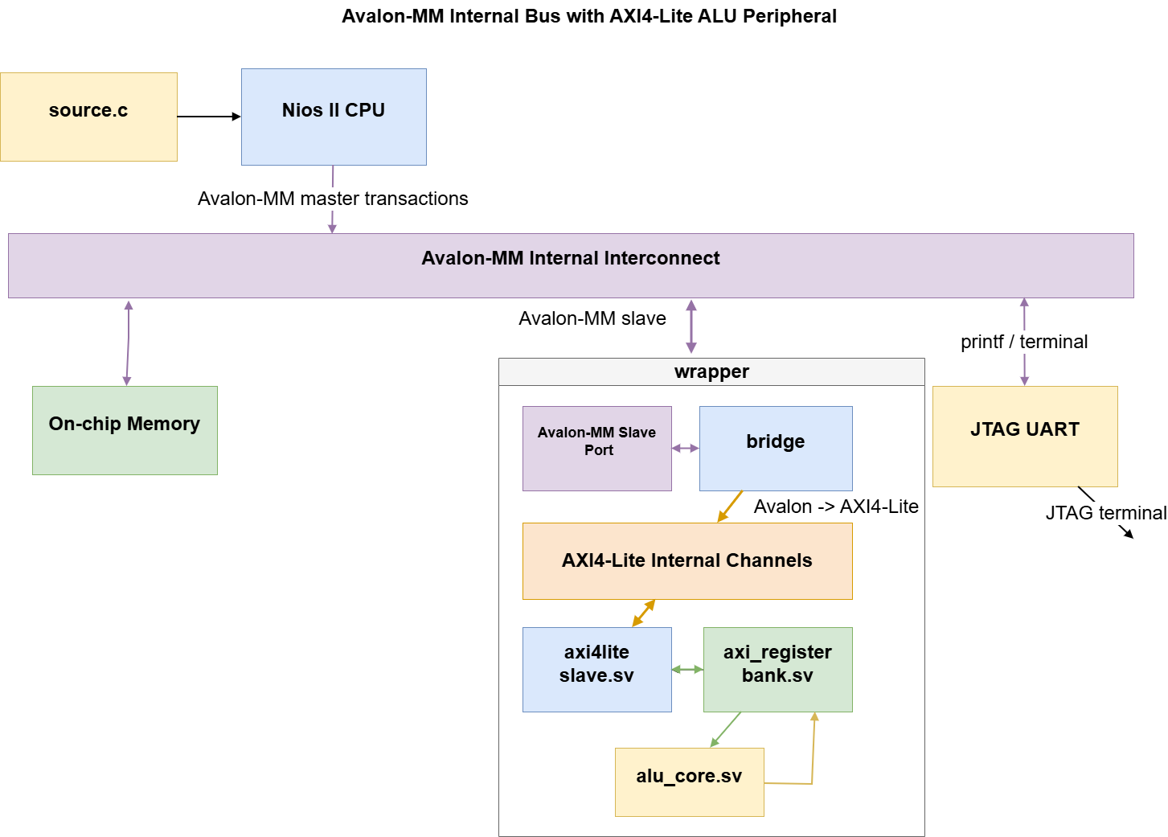
Project Scope & System Overview

Slide 14
KHOA KỸ THUẬT MÁY TÍNH
Project Scope & System Overview
Avalon-MM
Master
Avalon-to-AXI4Lite
Bridge (Avalon slave - axi4 lite master)
AXI4-Lite
Slave
Register
Bank
ALU
Core
Top-Level RTL Design
Verification Testbenches
The top-level hardware design integrates all core modules into a unified, functional system datapath.
TOP-LEVEL RTL FILE:
avalon_axi4lite_alu.sv
SYSTEM INTEGRATION:
■ Connects the Avalon-MM master interface cleanly to the ALU core.
■ Manages multi-protocol bus transfers across the register bank.
Verification relies on three primary targeted testbench environments designed to isolate and validate each module's core interfaces:
■ tb_avalon_axi4lite_bridge
Validates Avalon-MM to AXI4-Lite translation logic accuracy.
■ tb_axi4lite_slave
Validates the protocol slave compliance and state transition.
■ tb_axi_register_bank
Validates custom register-bank mapping and ALU instructions.
Copyrights 2026 CE-UIT. All Rights Reserved.

Slide 15
KHOA KỸ THUẬT MÁY TÍNH
Design Under Test (DUT) Architecture
Detailed block hierarchy and layered separation of the avalon_axi4lite_alu IP core
AVALON_AXI4LITE_BRIDGE
AXI4LITE_SLAVE
AXI_REGISTER_BANK
ALU_CORE
Bus Protocol Layer
■ Translates Avalon MM transactions to AXI4-Lite
■ Bridges master-slave interface protocols
Bus Protocol Layer
■ Manages standard AXI4-Lite channel handshakes
■ Handles bus reads and writes directly
Register Abstraction
■ Stores configuration data and control bits
■ Buffers operand values for ALU operations
ALU Datapath Layer
■ Executes arithmetic and logical hardware operations
■ Implements high-speed execution datapath
Key Specifications
■ Data Width: 32-bit data width
■ Address Width: 6-bit address width
■ Reset Signals: Active-low reset_n / aresetn
Copyrights 2026 CE-UIT. All Rights Reserved.

Slide 16
KHOA KỸ THUẬT MÁY TÍNH
KHOA KỸ THUẬT MÁY TÍNH
Register Map Specification
The axi_register_bank.sv file specifies the register configuration
ADDRESS
NAME
FUNCTION
0x00
CTRL
write bit 0 to start
0x04
STATUS
{error, done, busy}
0x08
A
operand A
0x0C
B
operand B
0x10
OPCODE
opcode 4-bit
0x14
RESULT
ALU result
invalid
default
read 0 / write ignored
Source: axi_register_bank.sv
Copyrights 2026 CE-UIT. All Rights Reserved.

Slide 17
KHOA KỸ THUẬT MÁY TÍNH
ALU Core Functionality & Arithmetic Logic
Arithmetic & Logic Operations
Error Handling & Exception Logic
The alu_core.sv module implements a highly optimized 32-bit arithmetic unit with 4 supported functions:
Opcode '0' (ADD): Performs 32-bit addition of inputs.
Opcode '1' (SUB): Performs 32-bit subtraction of inputs.
Opcode '2' (MUL): Performs 32-bit multiplication of inputs.
Opcode '3' (DIV): Performs 32-bit unsigned division.
Division-by-Zero Protection: Unsigned division operations automatically monitor the divisor. If division by zero is attempted:
• Output defaults to 32'h0 & asserts 'error' flag
Invalid Opcode Exception: The hardware verifies opcode ranges in real-time. Any value greater than the defined set asserts error:
• Opcode > 3 asserts 'error' output high
DIVISOR == 0
Unsigned Div-by-Zero
Result Output
32'h00000000
32
Data Width
32-Bit Operands
4
Opcode Width
4-Bit Opcode
Error Flag
ASSERTED (1'b1)
Source HDL: alu_core.sv
Copyrights 2026 CE-UIT. All Rights Reserved.

Slide 18
KHOA KỸ THUẬT MÁY TÍNH
AXI4-Lite Slave Interface & Handshaking
Write Handshaking Behavior
Response & Read Flow
axi4lite_slave.sv Protocol Support:
■Supports independent Address Write (AW) and Write Data (W) handshakes.
■Scenario 1: AW valid signal asserted before W valid.
■Scenario 2: W valid signal asserted before AW valid.
■Scenario 3: Concurrent AW and W validation in the same clock cycle.
Write Response (BRESP) Details:
■The write response (BRESP) is hardwired to always return OKAY upon completion.
Read Handshaking Flow:
■Initiated by an Address Read (AR) channel handshake.
■Followed immediately by an RVALID assertion to transmit read data.
Copyrights 2026 CE-UIT. All Rights Reserved.

Slide 19
KHOA KỸ THUẬT MÁY TÍNH
KHOA KỸ THUẬT MÁY TÍNH
Avalon-MM to AXI4-Lite Bridge Implementation
FSM control state machine and bridge control logic mechanics in avalon_axi4lite_bridge.sv
STATE 01
ST_IDLE
STATE 02
ST_WRITE
STATE 03
ST_WRITE_RESP
STATE 04
ST_READ_ADDR
STATE 05
ST_READ_DATA
Waitrequest Assertion
Phase Handshakes
Read Data Validity
■ Key control logic asserts avs_waitrequest to 1.
■ The assertion occurs and remains active when the bridge interface is busy.
■ Utilizes internal aw_done_q and w_done_q registers.
■ These dedicated registers handle phase-shifted AW/W AXI handshakes.
■ The avs_readdatavalid signal pulses active for exactly one cycle.
■ This signal assertion is triggered upon receiving RVALID.
Copyrights 2026 CE-UIT. All Rights Reserved.

Slide 20
KHOA KỸ THUẬT MÁY TÍNH
Verification Strategy & Testbench Framework
Register Bank Verification
Targeting modular verification of byte-enables and invalid addresses with 80 random iterations per testbench.
AXI Slave Verification
Focusing on handshake alignment and stalls. Verified modularly with 80 random iterations per testbench.
01
02
Bridge Verification
Targeting correct Avalon request translation. Driven by 80 random iterations per modular testbench.
240
Transactions
Total Scale & Strategy
Self-checking testbenches use custom check() tasks for PASS/FAIL logging. Stimulus combines directed cases and random patterns.
03
04
Copyrights 2026 CE-UIT. All Rights Reserved.

Slide 21
KHOA KỸ THUẬT MÁY TÍNH
Key Verification Scenarios of Register Bank
Data-Oriented Verification
Protocol-Oriented Control Flows
Reset Defaults: Core directed tests verify that operand, status, and result registers default to 0 on reset.
Timing Control: Write CTRL.START=1 → start_pulse asserted for exactly 1 clock cycle; STATUS.BUSY=1. .
32-Bit Access: Tests confirm full 32-bit reads/writes on Operands A (Adress 08) and B (Adress 0C).
State Rejection: Confirm busy state rejection of unexpected inputs.
Byte-Enables: Writing 0xAAAA5555 to 0x11223344 with strobe 4'b0101 (5 in dec) yields 0x11AA3355.
STATUS Done: Verify STATUS done states transition and assert correctly.
Opcode Masking:Verify that writes to the OPCODE register keep only wr_data[3:0]. For example, writing 0xFFFF_FF03 with wr_strb=4'b1111 must read back 0x00000003
Address Limits: Verify invalid address boundaries return 0 on read.
Copyrights 2026 CE-UIT. All Rights Reserved.

Slide 22
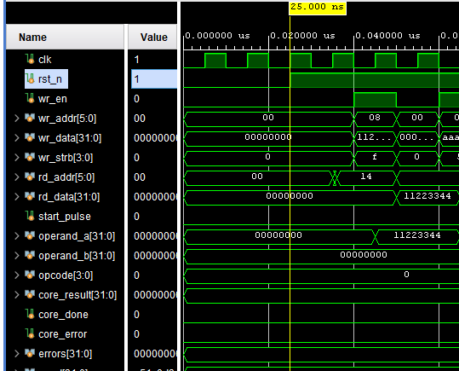
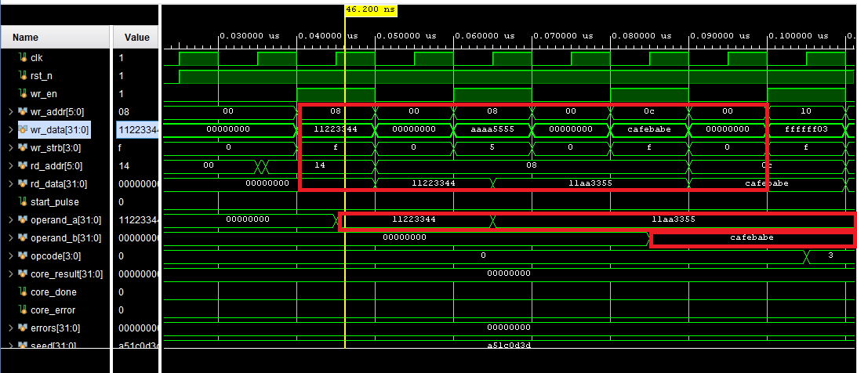
Key Verification Scenarios of RegisterBank
32-Bit Access: Tests confirm full 32-bit reads/writes on Operands A (Adress 08) and B (Adress 0C).
Reset Defaults: Core directed tests verify that operand, status, and result registers default to 0 on reset.

Slide 23
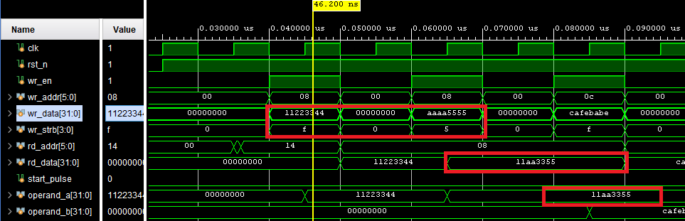
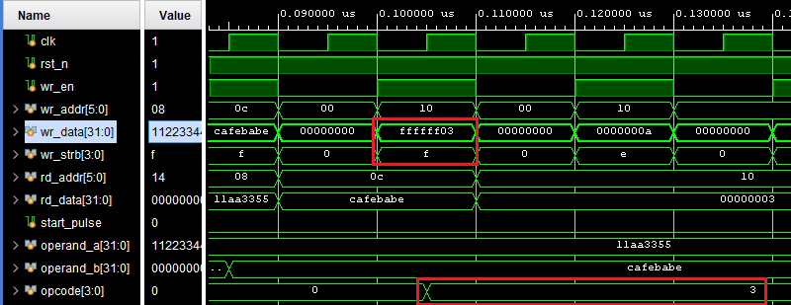
Key Verification Scenarios of RegisterBank
Byte-Enables: Writing 0xAAAA5555 to 0x11223344 with strobe 4'b0101 (5 in dec) yields 0x11AA3355.
Opcode Masking:Verify that writes to the OPCODE register keep only wr_data[3:0].
For example, writing 0xFFFF_FF03 with wr_strb=4'b1111 must read back 0x00000003

Slide 24
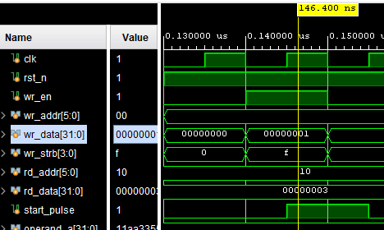
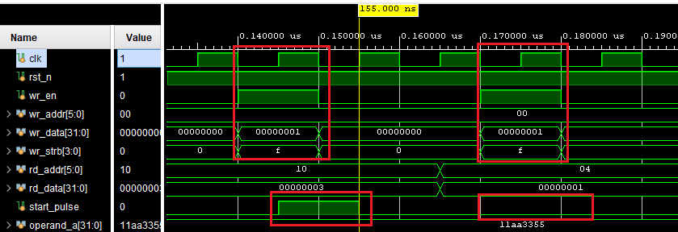
Key Verification Scenarios of RegisterBank
Timing Control: Start Pulse Timing: Write CTRL.START=1 → start_pulse asserted for exactly 1 clock cycle; STATUS.BUSY=1. .
State Rejection: Confirm busy state rejection of unexpected inputs.
0.145 us: The first start command is accepted; start_pulse = 1 and STATUS = 0x1.
0.155 us: start_pulse is cleared to 0, while STATUS remains 0x1.
0.160-0.170 us: A second CTRL = 1 write is issued while the register bank is busy.
0.175 us: start_pulse remains 0, confirming that the restart request is rejected.

Slide 25
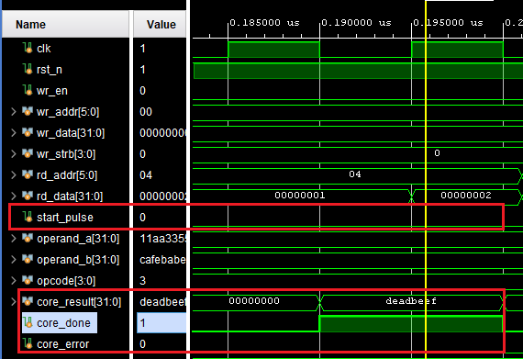
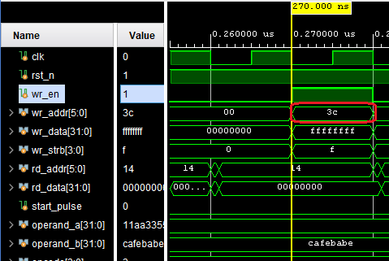
Key Verification Scenarios of RegisterBank
Address Limits: Verify invalid address (3c - not a valid address in Register Bank) boundaries return 0 on read. And not effect to operands A or B.
STATUS Done: Verify STATUS done states transition and assert correctly.
It verifies that when the ALU core completes successfully (core_done=1, core_error=0), the register bank must clear busy, set done, keep error deasserted, and latch core_result into the RESULT register.

Slide 26

KHOA KỸ THUẬT MÁY TÍNH
Protocol & Bridge Verification Scenarios
AXI4-Lite Slave Tests
Avalon Bridge Tests
■ Verify AW-before-W, W-before-AW (generating exactly one valid write pulse), and same-cycle AW/W writes.
■ Confirm ARVALID/ARREADY handshakes and back-to-back recovery during read transactions.
■ Validate write timing variations and delayed read responses.
AW/W, AR
AXI4-Lite
Avalon
Master
AXI Slave
Directed
Scenarios
AXI Master
AXI-Avalon
Bridge
Slave Core
READY
waitrequest
Copyrights 2026 CE-UIT. All Rights Reserved.

Slide 27
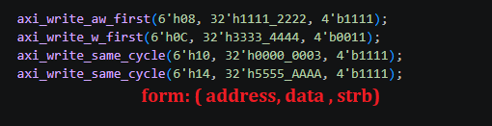
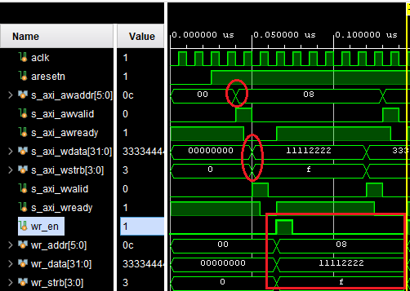
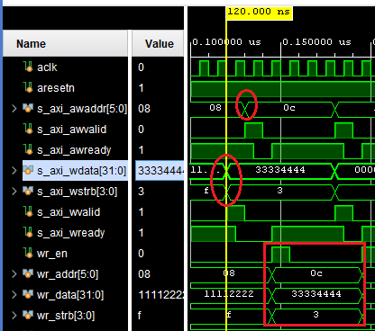
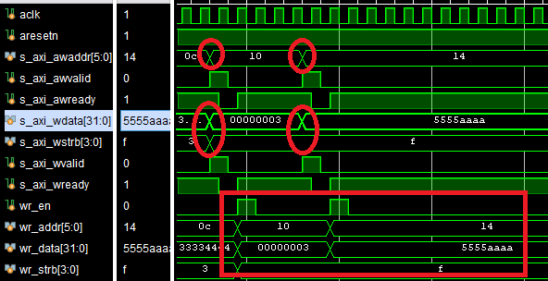
Protocol & Bridge Verification Scenarios
( axi 4 lite slave)
Verify that the slave handles all AW/W ordering cases:
AW-before-W: address arrives before data
W-before-AW: data arrives before address
Same-cycle AW/W: address and data arrive together.
In all cases, the slave waits until both address and data are received, then generates exactly one internal write pulse: wr_en = 1 for one clock cycle; This ensures each write transaction is committed once, independent of AW/W arrival order.

Slide 28

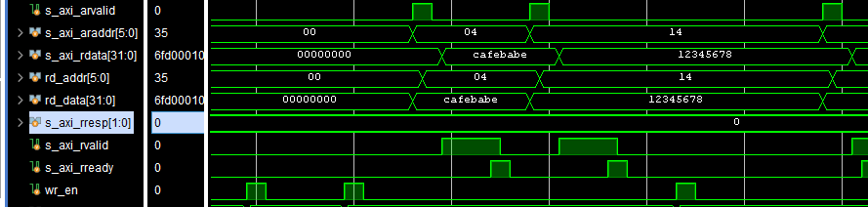
Protocol & Bridge Verification Scenarios
(axi 4 lite slave)
addr = 6'h04 addr = 6'h14
data = 32'hCAFE_BABE data = 32'h1234_5678
name = "read transaction" name = "back-to-back read"
This testcase verifies the AXI4-Lite slave read channel using two consecutive read transactions.
First, the test calls axi_read(6'h04, 32'hCAFE_BABE, "read transaction"), where the master drives s_axi_araddr = 6'h04 and asserts s_axi_arvalid; the slave accepts the request when s_axi_arready = 1, then returns s_axi_rvalid = 1, s_axi_rdata = 32'hCAFE_BABE, and s_axi_rresp = 2'b00.
After the first read response is completed with s_axi_rready = 1, the test immediately calls axi_read(6'h14, 32'h1234_5678, "back-to-back read") to check that the slave has recovered and can accept another ARVALID/ARREADY handshake, then return the expected RDATA = 32'h1234_5678.
This confirms correct read address handshaking, read response generation, and back-to-back read recovery.

Slide 29
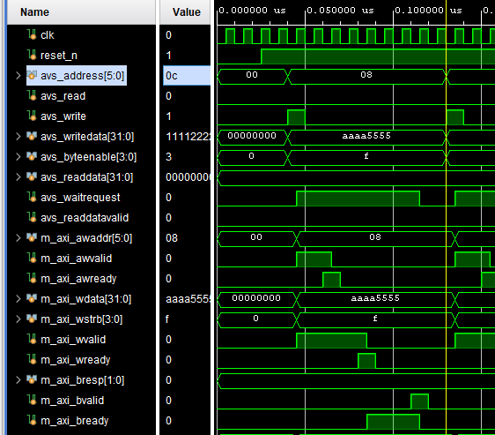
Protocol & Bridge Verification Scenarios (bridge)
avalon_write(6'h08, 32'hAAAA_5555, 4'b1111, 0, 0, 2, "write AW/W same cycle");
avalon_write(6'h0C, 32'h1111_2222, 4'b0011, 0, 3, 1, "write AW before W");
avalon_write_w_first(6'h10, 32'h0000_0002, 4'b1111);
avalon_read(6'h14, 32'hDEAD_BEEF, 2, 3, "read with delays");
avalon_write(6'h08, 32'hAAAA_5555, 4'b1111, 0, 0, 2, "write AW/W same cycle");
Case 1: Write AW/W Same Cycle verifies that an Avalon-MM write is correctly converted into an AXI4-Lite write transaction. The test drives avs_write=1 for one clock with avs_address=0x08, avs_writedata=0xAAAA_5555, and avs_byteenable=4'b1111.
+ The bridge is expected to assert avs_waitrequest=1 while busy, drive m_axi_awvalid=1 with m_axi_awaddr=0x08, and drive m_axi_wvalid=1 with m_axi_wdata=0xAAAA_5555, m_axi_wstrb=4'b1111.
+ AWVALID and WVALID must stay stable until AWREADY and WREADY handshakes occur.
+ Then the bridge asserts m_axi_bready=1, waits for m_axi_bvalid, completes the write response, and returns to idle with avs_waitrequest=0.
Expected output: the bridge completes the AXI write transaction successfully, keeps address/data stable until handshake, then returns to idle with avs_waitrequest = 0.

Slide 30
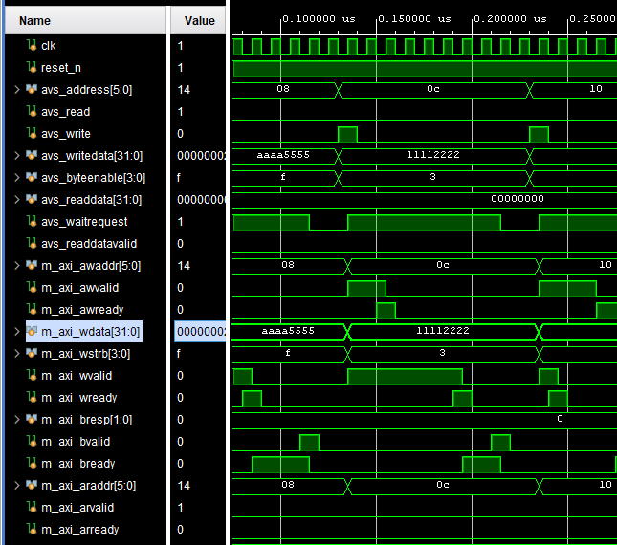
Protocol & Bridge Verification Scenarios (bridge)
avalon_write(6'h0C, 32'h1111_2222, 4'b0011, 0, 3, 1, "write AW before W");
Case 2: Write AW Before W verifies that the bridge correctly handles an AXI4-Lite write when the address channel completes before the data channel. The test drives an Avalon-MM write with avs_address=0x0C, avs_writedata=0x1111_2222, and avs_byteenable=4'b0011.
With aw_delay=0, the testbench asserts m_axi_awready immediately, so the bridge handshakes m_axi_awvalid and m_axi_awaddr=0x0C first.
With w_delay=3, m_axi_wready is delayed by three clock cycles, so the bridge must keep m_axi_wvalid=1, m_axi_wdata=0x1111_2222, and m_axi_wstrb=4'b0011 stable while waiting.
After the W handshake, b_delay=1 delays the write response by one clock cycle; the bridge asserts m_axi_bready=1, waits for m_axi_bvalid, completes the response, and returns to idle with avs_waitrequest=0.

Slide 31
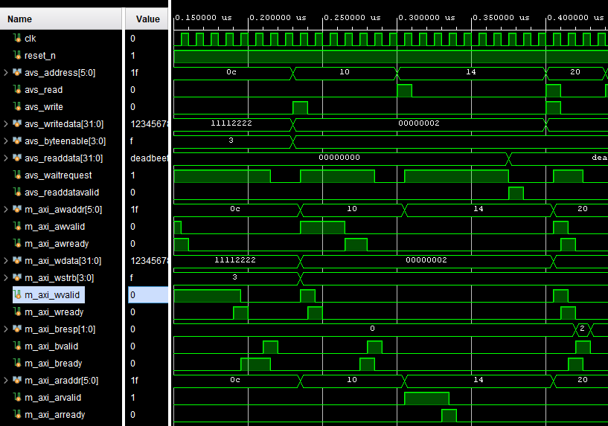
Protocol & Bridge Verification Scenarios (bridge)
avalon_write_w_first(6'h10, 32'h0000_0002, 4'b1111);
Case 3: Write W Before AW verifies that the bridge correctly handles an AXI4-Lite write when the data channel is accepted before the address channel.
The test drives an Avalon-MM write with avs_address=0x10, avs_writedata=0x0000_0002, and avs_byteenable=4'b1111.
The testbench asserts m_axi_wready first, so the W channel handshakes before the AW channel; after this handshake, the bridge must deassert m_axi_wvalid because the write data has already been accepted.
At the same time, it must keep m_axi_awvalid=1 and m_axi_awaddr=0x10 stable until m_axi_awready is asserted.
Once the AW handshake completes, the bridge waits for m_axi_bvalid with m_axi_bready=1, completes the write response, and returns to idle.

Slide 32
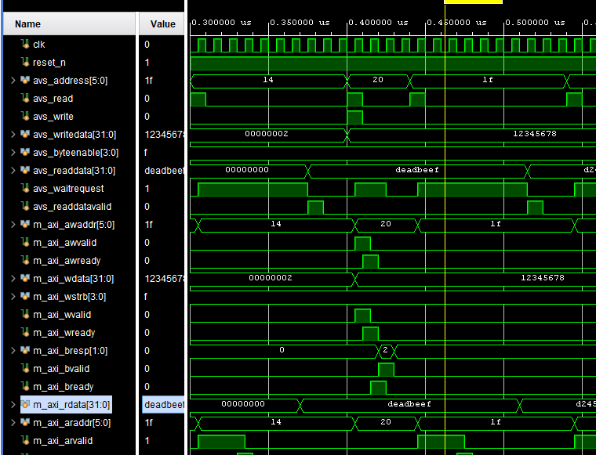
Protocol & Bridge Verification Scenarios (bridge)
avalon_read(6'h14, 32'hDEAD_BEEF, 2, 3, "read with delays");
Case 4: Read With Delays verifies that the bridge correctly converts an Avalon-MM read request into an AXI4-Lite read transaction while handling delayed address and data responses.
The test drives avs_read=1 for one clock cycle with avs_address=0x14.
With ar_delay=2, the testbench delays m_axi_arready for two clock cycles, so the bridge must keep m_axi_arvalid=1 and m_axi_araddr=0x14 stable until the AR handshake occurs.
After the address is accepted, r_delay=3 delays the read data response, so the bridge must assert and hold m_axi_rready=1 while waiting for m_axi_rvalid.
When the testbench returns m_axi_rdata=0xDEAD_BEEF with m_axi_rvalid=1, the bridge outputs avs_readdata=0xDEAD_BEEF and asserts avs_readdatavalid=1 for exactly one clock cycle, then returns to idle.

Slide 33
KHOA KỸ THUẬT MÁY TÍNH
Coverage Report & Synthesis Analysis
SYNTHESIS & COVERAGE OVERVIEW
DESIGN MODULE
TESTBENCH REPORT
RTL STANDALONE TARGET
axi_register_bank
Statement 98.46% | Branch 91.30%
Condition 0% | Toggle 30.93%
Statement 100% | Branch 100%
Condition 0% | Toggle 44.73%
Vivado Simulator Analysis
Standalone target RTL modules achieved 100% statement and branch coverage.
The tb_avalon_axi4lite_bridge report hit 98.75% Statement and 92.86% Branch coverage.
axi4lite_slave
Statement 98.61% | Branch 90.48%
Condition 0% | Toggle 15.30%
Statement 100% | Branch 100%
Condition 0% | Toggle 15.69%
avalon_axi4lite_bridge
Statement 98.75% | Branch 92.86%
Condition 52.38% | Toggle 20.73%
Statement 100% | Branch 100%
Condition 100% | Toggle 29.92%
Vivado Simulator Coverage Report 2023.1, 17/07/2026
Copyrights 2026 CE-UIT. All Rights Reserved.

Slide 34
KHOA KỸ THUẬT MÁY TÍNH
KHOA KỸ THUẬT MÁY TÍNH
FPGA Implementation & Platform Integration
Cyclone IV E platform target and Qsys system design integration
FPGA Platform
Target Device
Top Entity & Clock
IP & Integration
PLATFORM FAMILY
Cyclone IV E
TARGET ROLE
Low-power, low-cost system design and hardware verification prototyping.
SUPPORTED TOOLCHAIN
Quartus Prime design software integration.
DEVICE PART NUMBER
EP4CE22F17C6
HARDWARE RESOURCES
• 22,320 Logic Elements
• 154 M9K Memory Blocks
• 75 Embedded Multipliers
• 153 Max User I/O Pins
DESIGN TOP ENTITY
AXI_LITE_RESEARCH
SYSTEM CLOCK CONFIG
• Signal: CLOCK_50
• FPGA Pin: Pin R8
• Frequency: 50 MHz input reference
IP PACKAGING
Platform Designer IP packaged via ALU_AXI4_LITE_hw.tcl, incorporating all 5 RTL files.
QSYS SYSTEM CONFIG
System generation configuration path:
quartus/system.qsys
Copyrights 2026 CE-UIT. All Rights Reserved.

Slide 35
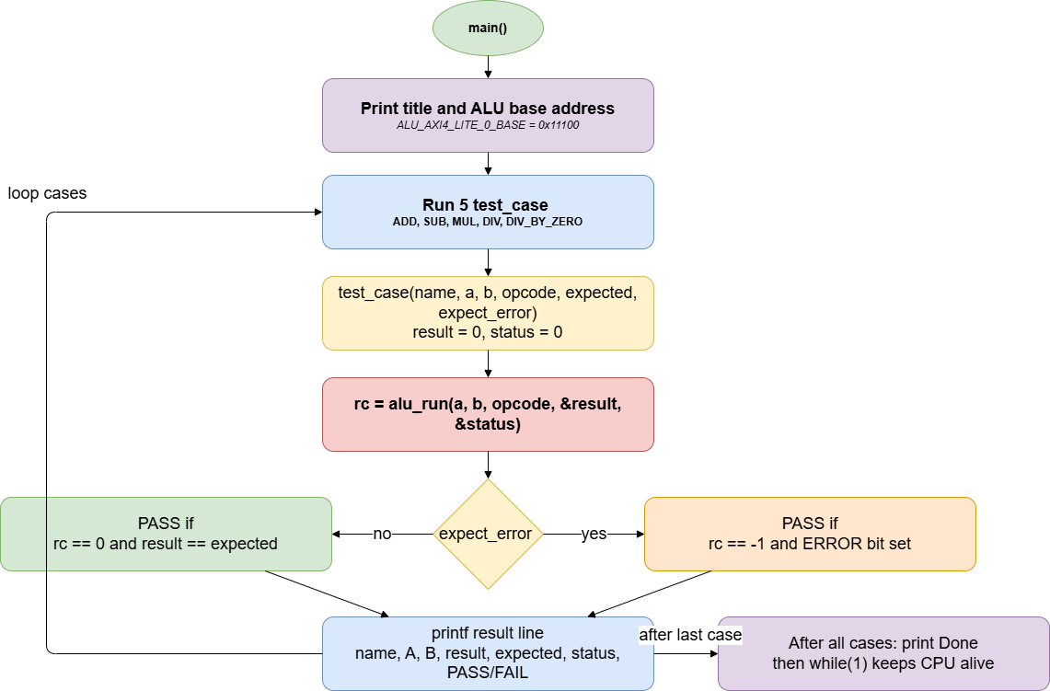
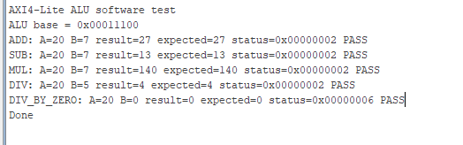
Software ASM& Result

Slide 36


KHOA KỸ THUẬT MÁY TÍNH
Conclusion & Future Outlook
Project Achievements
Future Enhancements
Successfully verified register behavior, AXI4-Lite compliance, and Avalon-to-AXI translation.
Robust testbenches uncovered boundary corner cases.
Standalone RTL blocks scored 100% in branch and statement coverage.
Implement end-to-end transaction testing for avalon_axi4lite_alu.
Add standalone ALU core coverage.
Develop functional coverage (covergroups) for transitions.
Assert AXI handshake stability.
100%
RTL Coverage Achieved
Branch & statement standalone block results
04
Key Objectives Defined
Next phase verification roadmap
Copyrights 2026 CE-UIT. All Rights Reserved.

Slide 37

KHOA KỸ THUẬT MÁY TÍNH
References
Copyrights 2026 CE-UIT. All Rights Reserved.

